Slide 1
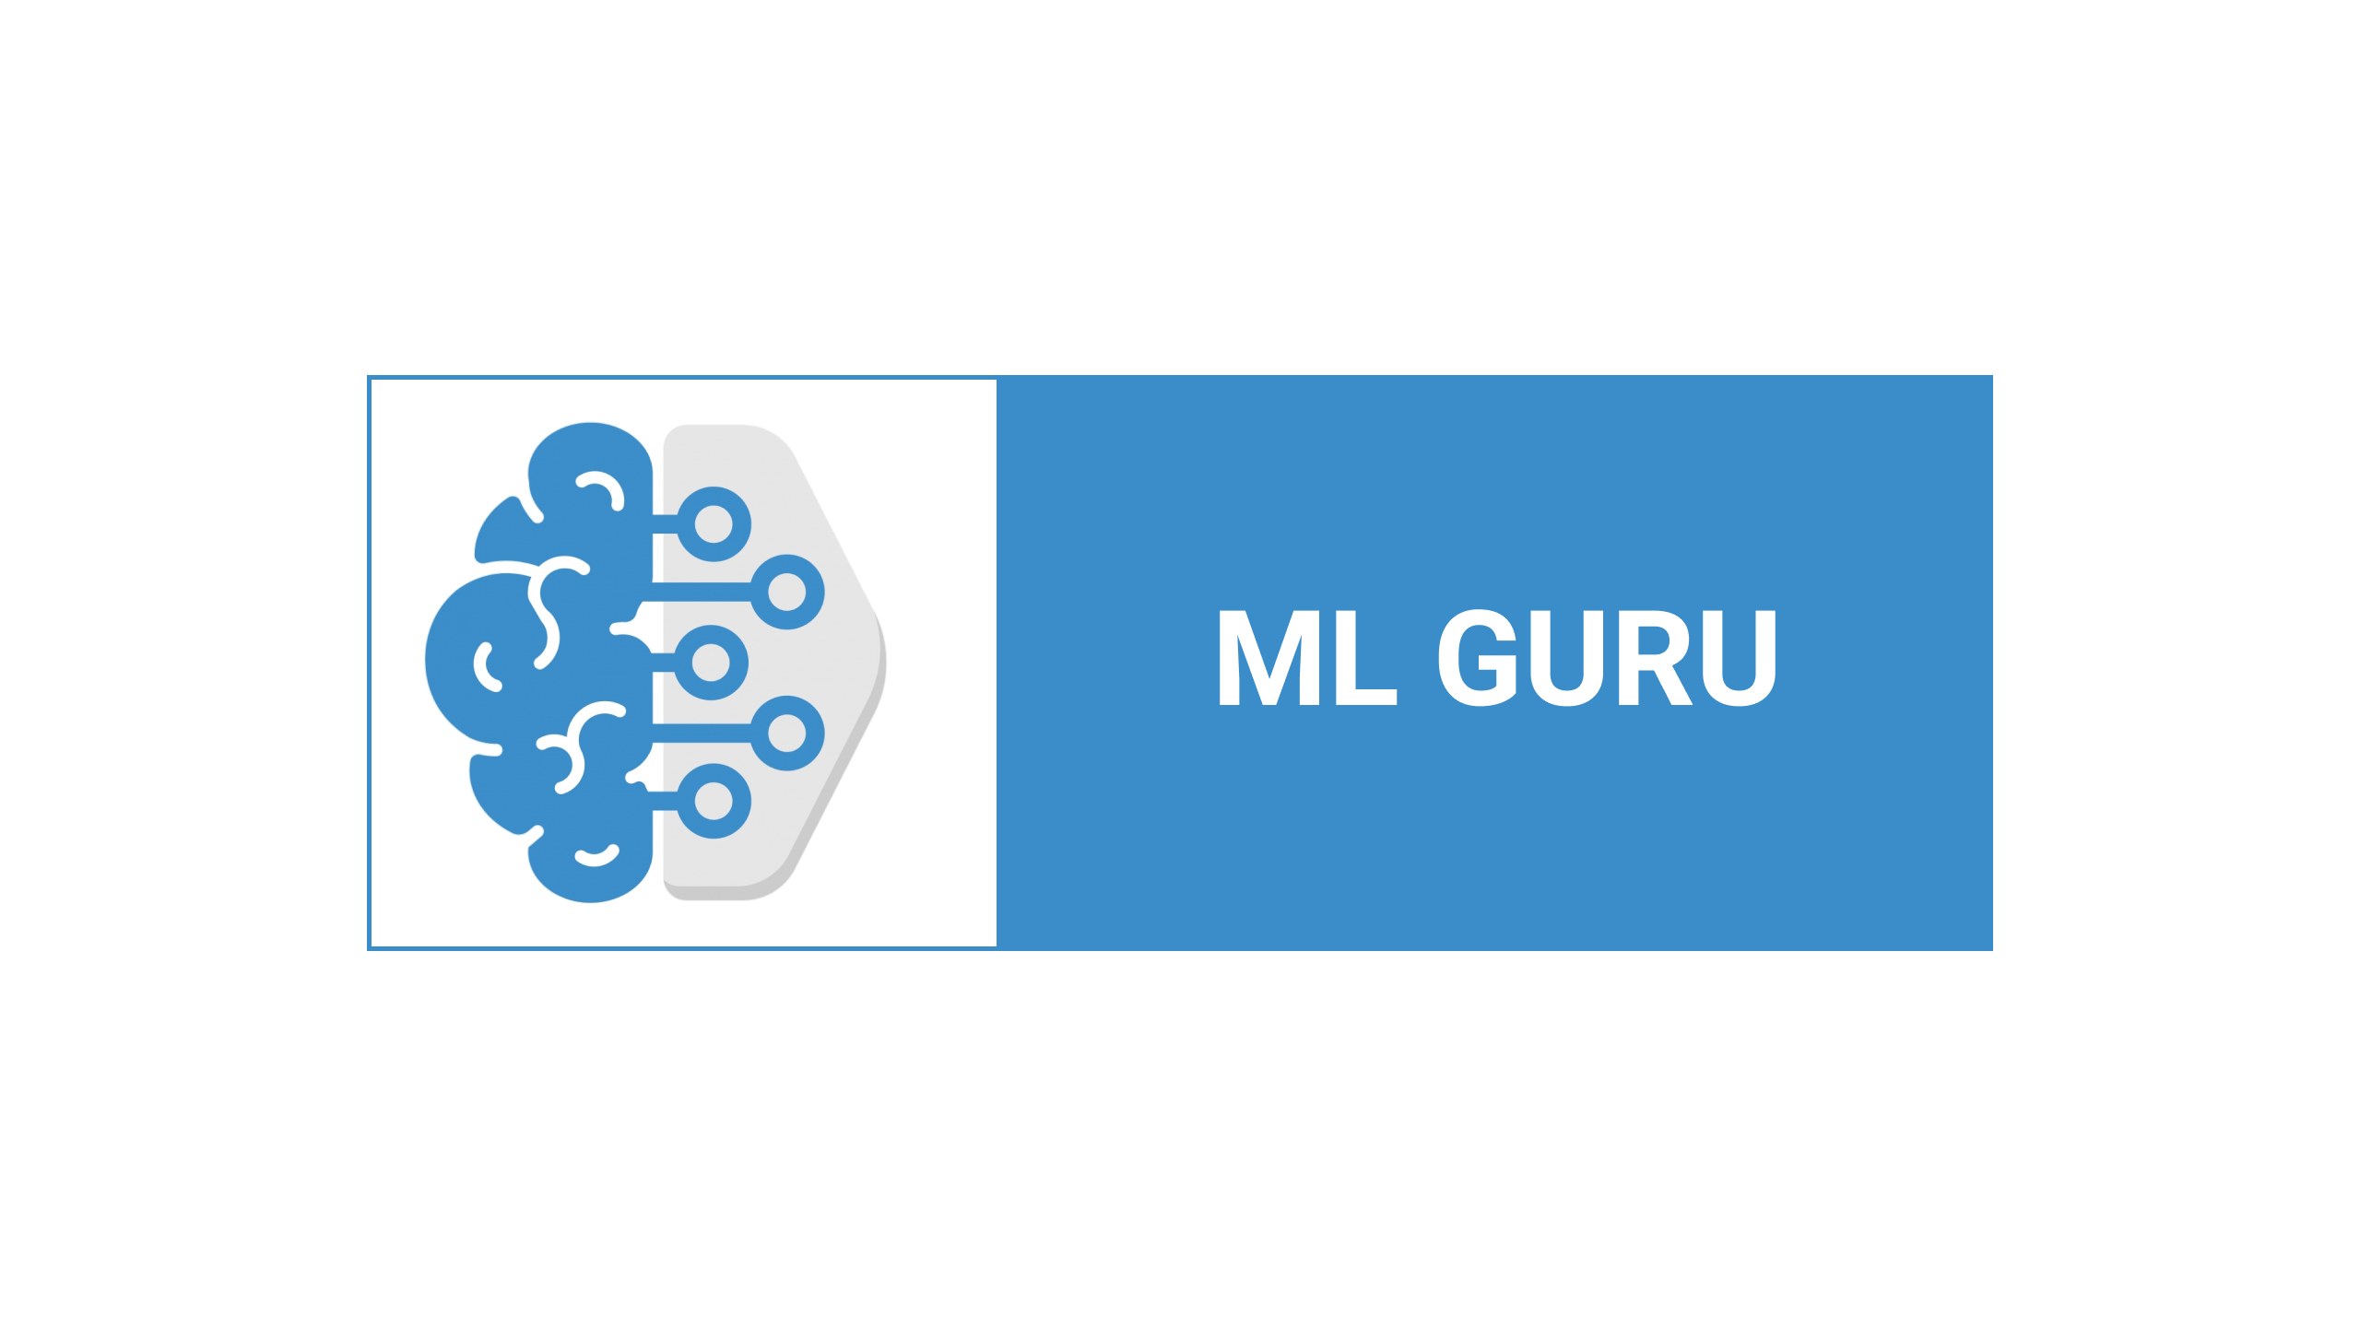

Slide 2
Lecture By Arjun Pukale

Slide 3

Data and Task

Slide 4



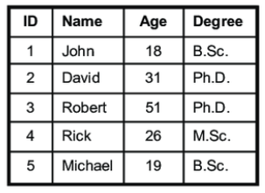

Data and Task

Slide 5
Data and Task
Numeric Data

Slide 6
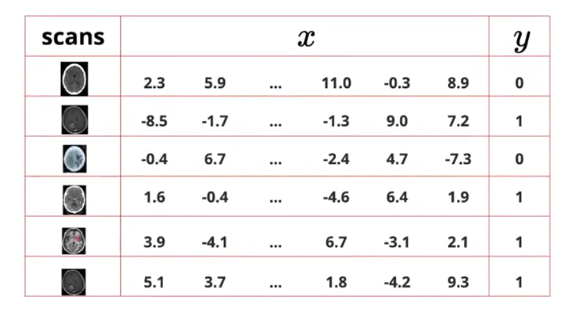
Data and Task

Slide 7
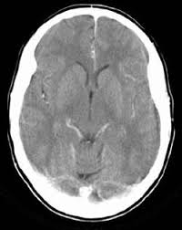
Data and Task
Trained Model
Yes/No

Slide 8
Data and Task

Slide 9
Data and Task
x2,y2
x1,y1

Slide 10
Data and Task
(x1,y1) | (x2,y2)
x2,y2
x1,y1

Slide 11
Data and Task
(x1,y1) | (x2,y2)
Trained Model

Slide 12
Data and Task
(x1,y1) | (x2,y2)
There is nothing much I can do with this data!!!
Trained Model

Slide 13
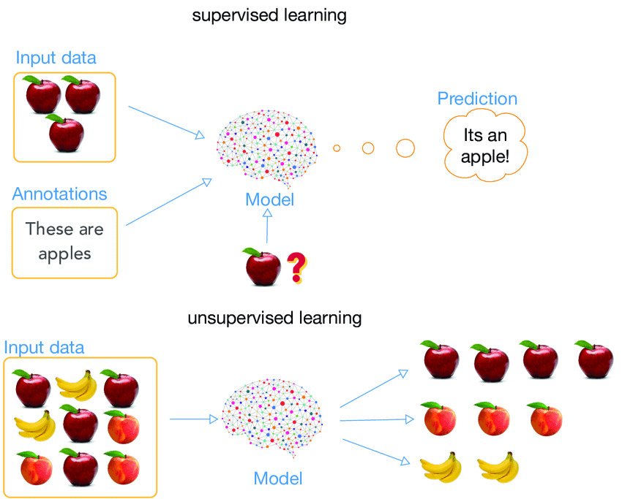
Classification of Machine Learning

Slide 14
Supervised Learning

Slide 15
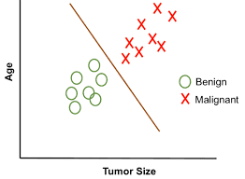
Supervised Learning
Classification
Tumour size | Age | Malignant
1.5 | 4 | 0
2 | 2 | 0
3.4 | 6 | 1
… | … | …
Tumour size

Slide 16
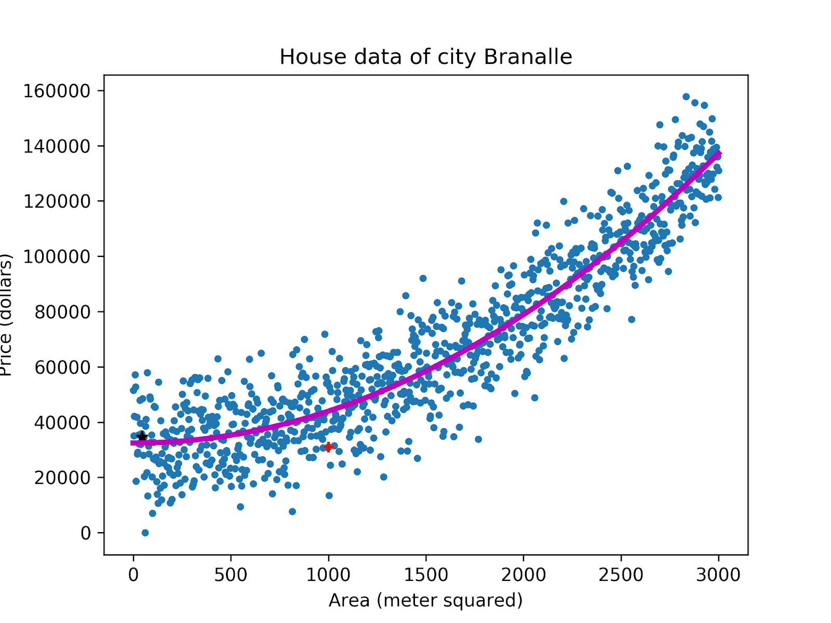
Supervised Learning
Regression
Area | Price
500 | 45000
200 | 21024
2000 | 100533
… | …

Slide 17
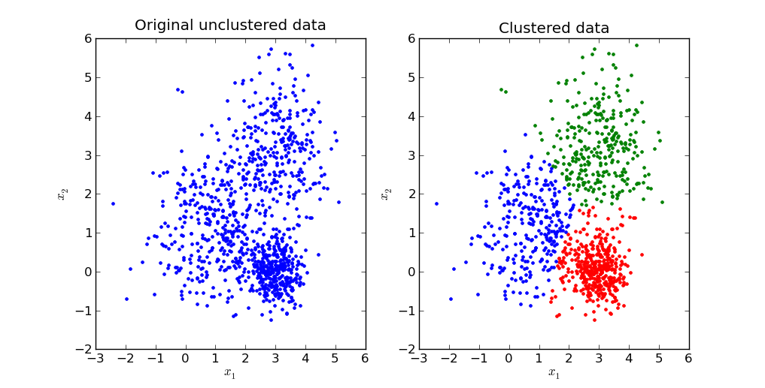
Unsupervised Learning
Clustering
x1 | x2
1 | -0.75
3.5 | 2.8
5 | 3
….. | …..

Slide 18
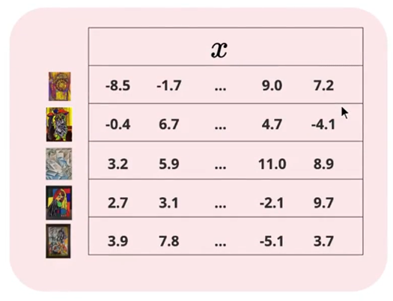
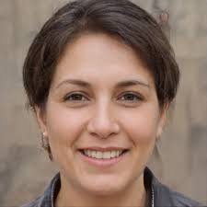
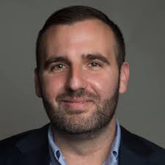
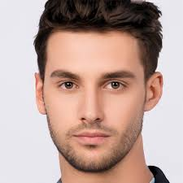
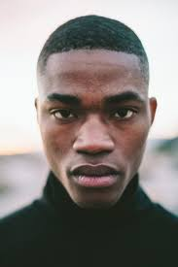
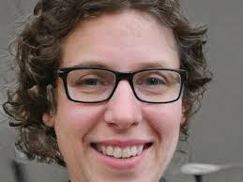
Unsupervised Learning
Generation
Generator

Slide 19
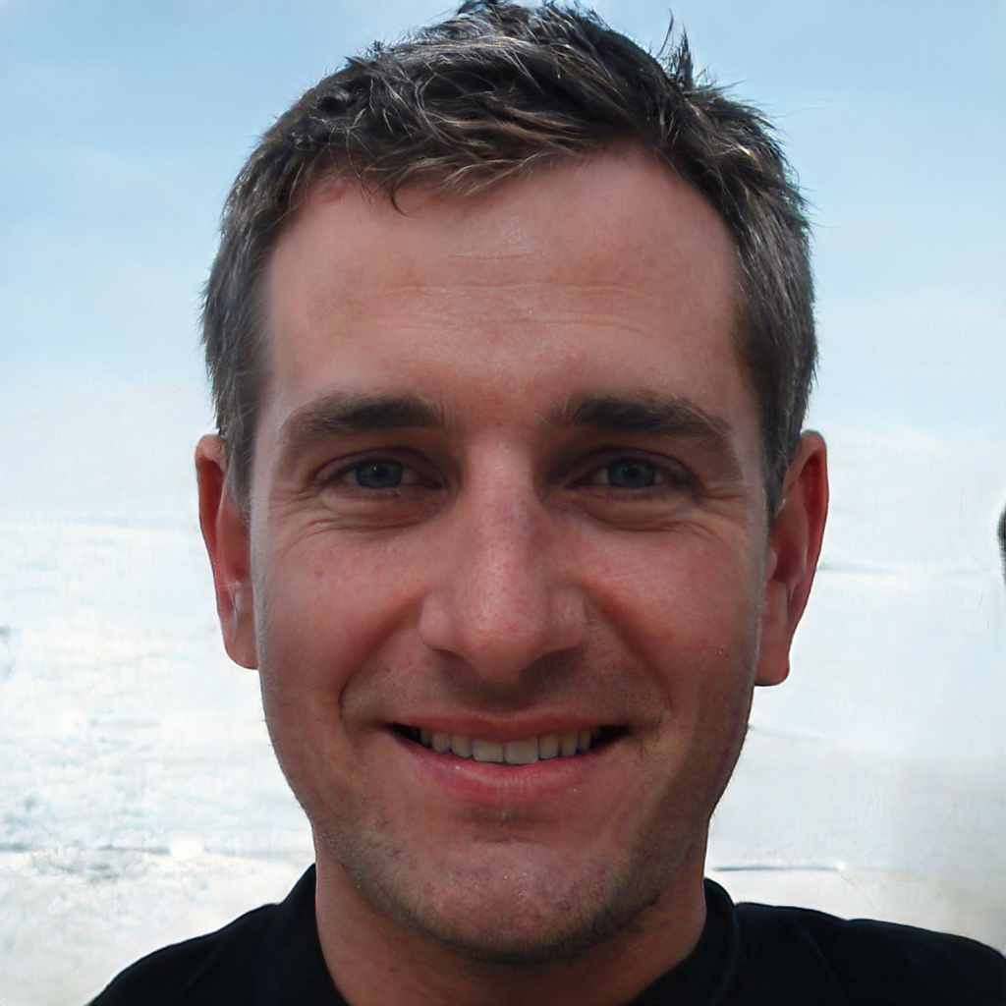
Unsupervised Learning
Generation
Generator

Slide 20



